Slide 1

BATCH IN 2019

Slide 2
Safe Harbor Statement
The following is intended to outline the general direction of Pivotal's offerings. It is intended for
information purposes only and may not be incorporated into any contract. Any information
regarding pre-release of Pivotal offerings, future updates or other planned modifications is
subject to ongoing evaluation by Pivotal and is subject to change. This information is provided
without warranty or any kind, express or implied, and is not a commitment to deliver any
material, code, or functionality, and should not be relied upon in making purchasing decisions
regarding Pivotal's offerings. These purchasing decisions should only be based on features
currently available. The development, release, and timing of any features or functionality
described for Pivotal's offerings in this presentation remain at the sole discretion of Pivotal.
Pivotal has no obligation to update forward looking information in this presentation.

Slide 3

2019!

Slide 4

ANY REPLICANTS?

Slide 5


HOVERBOARDS OR FLYING CARS?

Slide 6
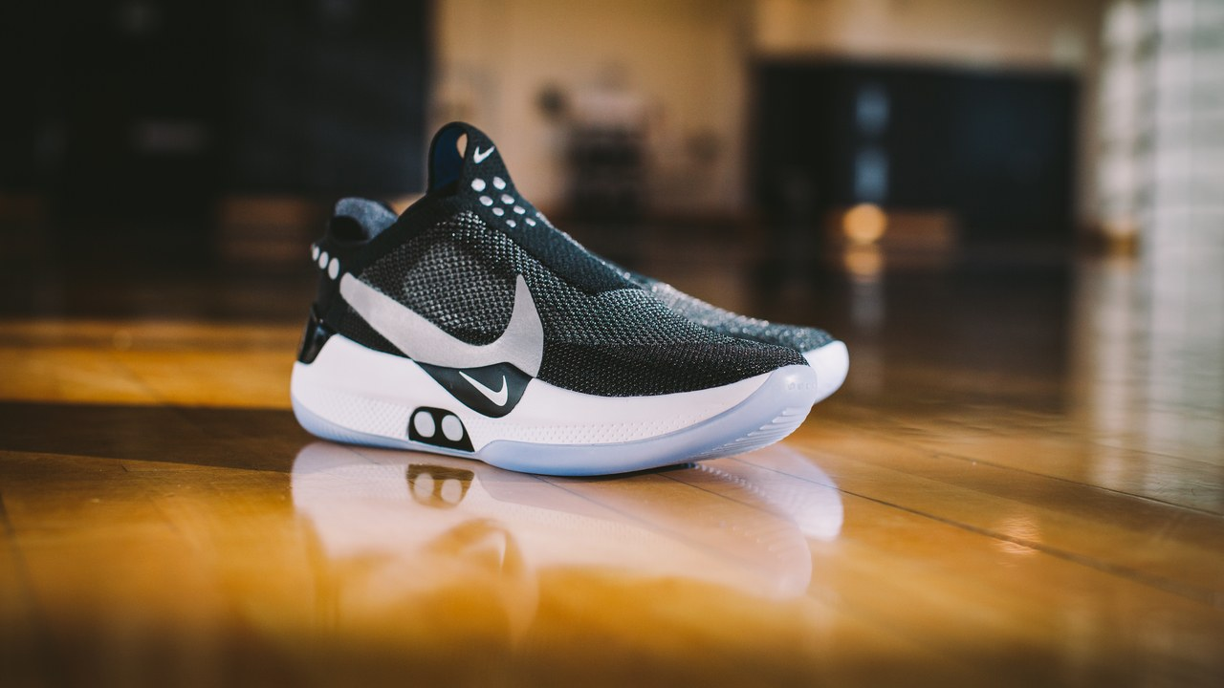
SELF LACING SHOES!

Slide 7
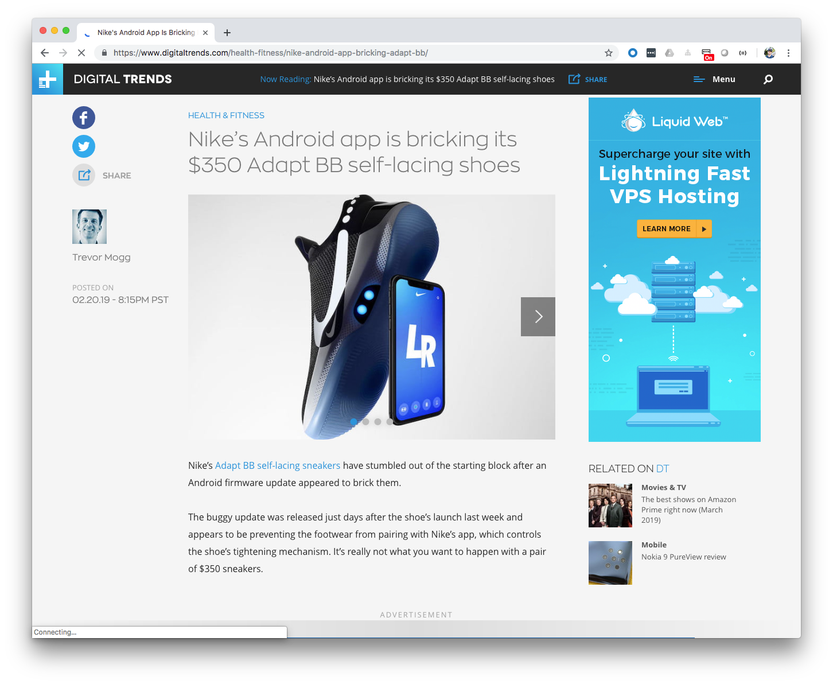

Slide 8

ALL THESE AMAZING THINGS
THE FUTURE HAS BROUGHT US…

Slide 9


Slide 10
고맙습니다!
شكرا لك.
Hvala vam!
Merci!
¡Gracias!
Dziękuję!
Благодарю!
धन्यवाद।
THANK YOU!
Danke!
Děkuju!
Grazie!
Sağol!
Obrigado!
Благодаря!
谢谢!

Slide 11


MICHAEL MINELLA
Lead | Spring Batch & Spring Cloud Task
JSR-352 | Expert Group Member and Committer
Author | Pro Spring Batch and The D G to Spring Batch
Speaker | JavaOne Rockstar and Java Champion
Podcast | OffHeap Curmudgeon

Slide 12
@michaelminella
@OffHeap

Slide 13

AVAILABLE
NOW!
https://www.apress.com/us/book/9781484237236

Slide 14

http://www.javaoffheap.com/

Slide 15

SLIDES AND CODE
ARE ON GITHUB
https://github.com/mminella/Batch-In-2019
Notes:
S1P 2018 branch was used in the presentation at Spring One Platform 2018

Slide 16

Notes:
Please ask questions when you have them

Slide 17


LAY OF THE LAND

Slide 18

SPRING FRAMEWORK

Slide 19
SPRING BATCH

Slide 20

SPRING CLOUD DATA FLOW

Slide 21

MICROMETER

Slide 22

PROMETHEUS

Slide 23

GRAFANA

Slide 24
¯\_(ツ)_/¯

Slide 25

DAY IN THE LIFE OF
A BATCH DEVELOPER

Slide 26

GET OUR COFFEE

Slide 27

CHECK THE STATUS
OF THE EXISTING JOBS

Slide 28

ADD A NEW FEATURE

Slide 29

GO TO
PRODUCTION!

Slide 30

CHECK THE STATUS
OF THE EXISTING JOBS

Slide 31



Spring Batch/Spring Cloud Task
Push Gateway
Prometheus
Grafana
Spring Cloud Data Flow

Slide 32

ADD A NEW FEATURE

Slide 33
Step1
Step2
ItemReader
Tasklet
ItemWriter

Slide 34

GO TO
PRODUCTION!

Slide 35
Github
CircleCI
Spring Cloud Data Flow
Maven Repository

Slide 36

LOOKING AHEAD

Slide 37
SPRING BATCH 4.1.2.RELEASE

Slide 38
SPRING BATCH 4.2.0.M2

Slide 39
SPRING BATCH 4.2.0.RELEASE

Slide 40

PERFORMANCE

Slide 41
METRICS VIA
MICROMETER

Slide 42

READING & WRITING TO
APACHE KAFKA

Slide 43
SPRING CLOUD DATA FLOW 2.2!

Slide 44

ACCESS TO
LOGS!

Slide 45
TASK METRICS
VIA MICROMETER

Slide 46

STOP
TASKS

Slide 47
REPOSITORY
CLEANUP

Slide 48
Notes:
Please ask questions when you have them

